Slide 1
DEEP LEARNING
The ffNN challenge
Jose Antonio Ruiz Heredia
Hector Carlos Flores Reynoso
Alvaro Honrubia

Slide 2
THE PROBLEM
Problem
Scope
Observations
Given a set of images (224px, 224px) create a classifier that is able to detect the vehicle type.
Create a baseline to define if Forward-Feed Neural Networks are enough for image classification
Models are compared using metrics such a mean accuracy, recall and precision.

Slide 3
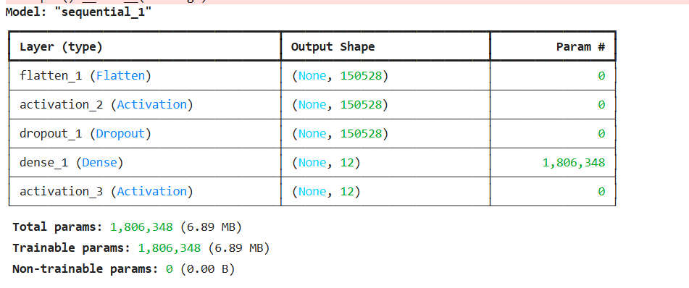
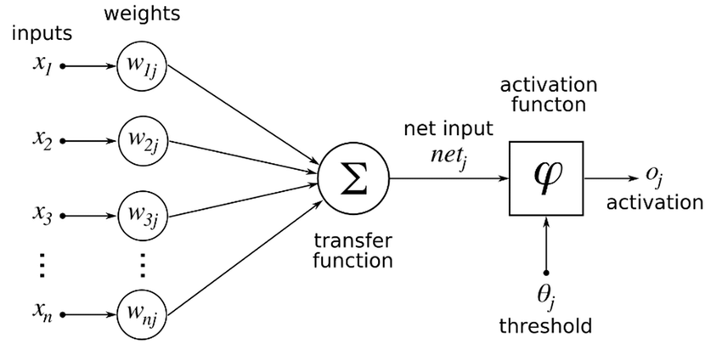
ARCHITECTURE

Slide 4
THE PROCESS
Environment Provisioning
Dataset preparation
Model training
Parameter Hypertunning
Two environments where used:
Kaggle with "GPU T4 x2" accelerator
Dev Containers (local) with RTX 4060
Download custom dataset
Convert each image into image vector
Split dataset into 90% training and 10% test
Run base model
Save base metrics
Increase batch size
Adam optimizer:
Alpha
Beta 1/2
Epsilon
SGD with binary cross entropy / mean_squared_error

Slide 5
MODEL ITERATIONS
00
01
02
03
04
Base Model
Increase Batch size
Decrease Early Stopping
and LR Reduction
Decrease Learning rate
Decrease Beta 1 and Epsilon
Increase Batch size
Increase Beta 2
Change Adam optimizer to SGD with binary_crossentropy / mean_square_error

Slide 6
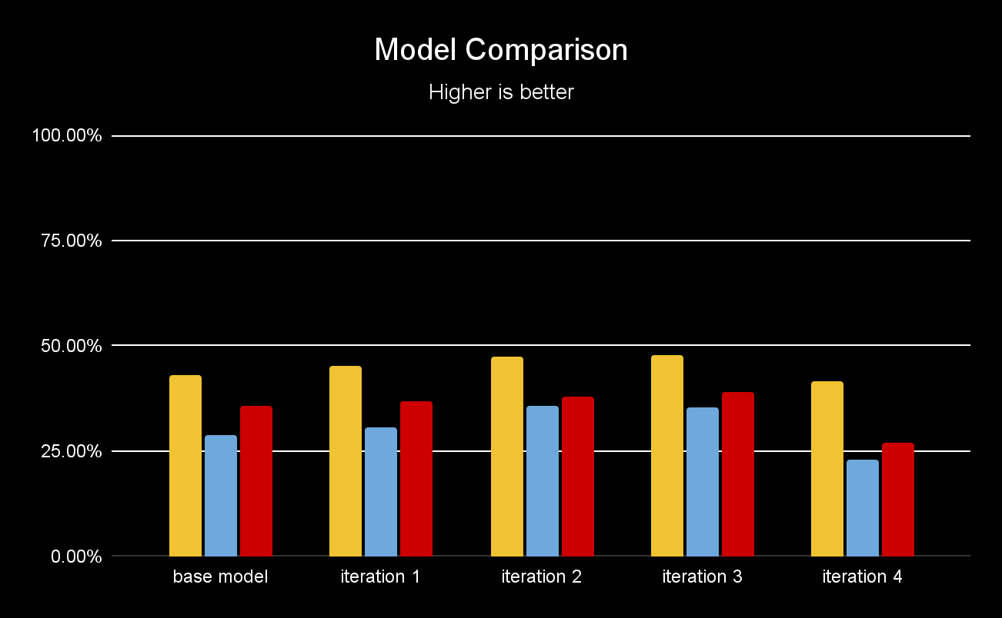
MODEL METRICS
BEST MODEL:
- Greater batch size 32 to 64
- Beta 2 parameter from 0.9 to 0.999
Accuracy
Recall
Precision

Slide 7
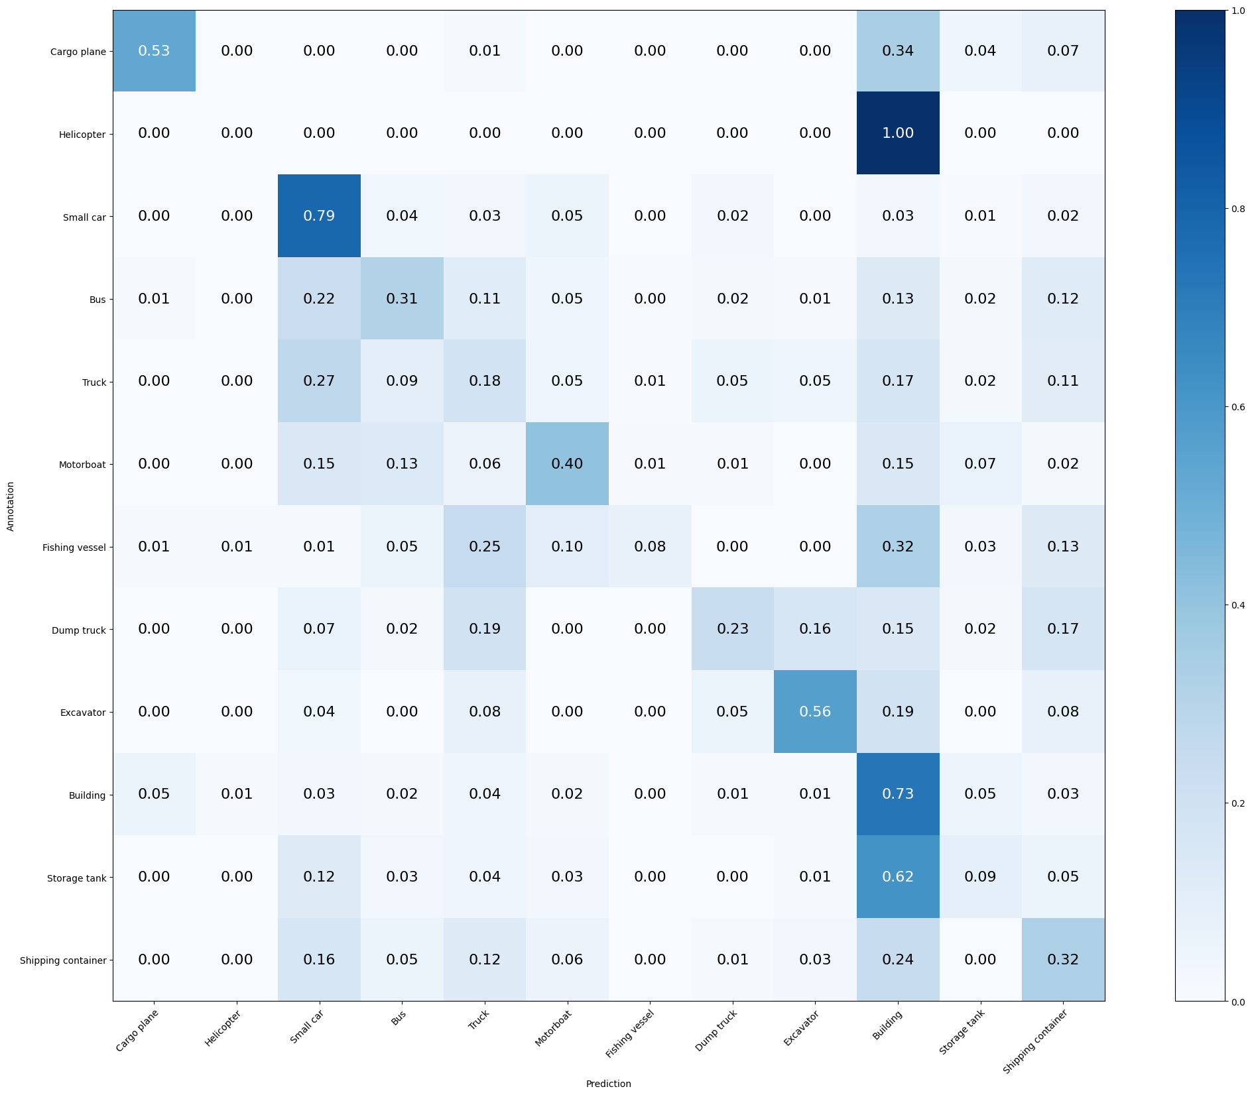
BEST MODEL
Mean Accuracy: 47.895%
Mean Recall: 35.316%
Mean Precision: 39.007%
> Cargo plane: Recall: 52.941% Precision: 54.545% Specificity: 98.551% Dice: 53.731%
> Helicopter: Recall: 0.000% Precision: 0.000% Specificity: 99.719% Dice: 0.000%
> Small car: Recall: 78.571% Precision: 61.914% Specificity: 88.184% Dice: 69.255%
> Bus: Recall: 31.050% Precision: 45.946% Specificity: 95.831% Dice: 37.057%
> Truck: Recall: 18.491% Precision: 26.203% Specificity: 92.632% Dice: 21.681%
> Motorboat: Recall: 40.449% Precision: 33.028% Specificity: 96.437% Dice: 36.364%
> Fishing vessel: Recall: 7.792% Precision: 54.545% Specificity: 99.757% Dice: 13.636%
> Dump truck: Recall: 23.077% Precision: 39.706% Specificity: 97.971% Dice: 29.189%
> Excavator: Recall: 56.410% Precision: 48.352% Specificity: 97.718% Dice: 52.071%
> Building: Recall: 73.387% Precision: 53.846% Specificity: 80.999% Dice: 62.116%
> Storage tank: Recall: 9.150% Precision: 22.222% Specificity: 97.531% Dice: 12.963%
> Shipping container: Recall: 32.468% Precision: 27.778% Specificity: 93.448% Dice: 29.940%

Slide 8
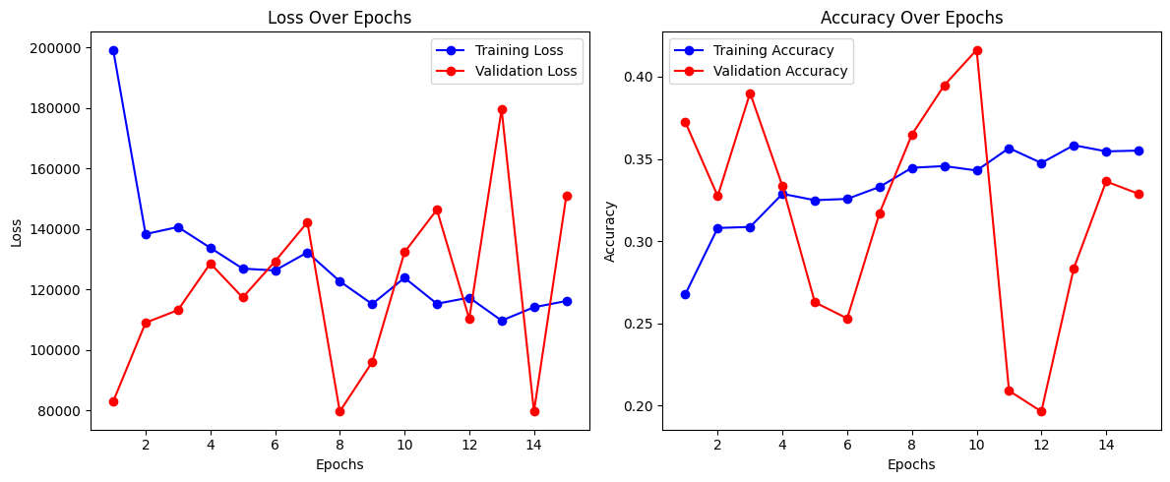
EVOLUTION OF COSTS AND CLASSIFICATION PERFORMANCE

Slide 9
FUTURE
Use pipeline to normalize data and test different parameter hypertunning
Use different data set variation (with stratification) since there seems to be an imbalance among classes
Further breakdown dataset to add a validation dataset to calculate loss

Slide 10
CONCLUSIONS
ffNN INNEFFICENCY
OPTIMIZERS
LOSS FUNCTION
LEARNING RATE SENSIBILITY
Unoptimized for large and complex image classification problems
SGD did not improved performance of Adam optimizer, needs further hypertunning
Small changes in parameter can have a big impact
Probabilistic loss are better for classifying labels
The loss function influence the classification output ratio.
Finding the optimal learning rate is crucial
Too Low: Model may fail to converge
Too High: Model may diverge (unstable training)

